Slide 1


George García
May 24, 2023

Slide 2

Outline
Executive Summary
Introduction
Methodology
Results
Conclusion
Appendix

Slide 3
Executive Summary
Summary of methodologies
This project uses data collection, wrangling, exploration, visualization and machine learning to pull insights about what made SpaceX so successful in their landings
Summary of all results
Analysis of the results showed that improvements arrived quickly around 2015, but with a wide error margin. After 2017 this margin has been reducing its size, increasing its effective success rate.

Slide 4
Introduction
Recovering the 1st stage of a rocket launch
decreases the cost of subsequent launches.
They can be reused on other launches as well as
give design feedback for engineers.

Slide 5
Introduction
The Question:
What features allow the 1st phase to be more recoverable?
To answer this, we will use Data Science methodology to gain insights from SpaceX landing data.
We can gain insights as to what makes a successful launch & landing

Slide 6

Section 1

Slide 7
Methodology
Executive Summary
Data collection methodology:
Data on each launch was collected directly from SpaceX public data.
Data on model names and measurements were taken via webscraping
Perform data wrangling
Collected data was formatted and normalized. Small samples of NaN results were ignored
Perform exploratory data analysis (EDA) using visualization and SQL
Perform interactive visual analytics using Folium and Plotly Dash
Perform predictive analysis using classification models
Machine Learning Models were trained to correctly predict landing success

Slide 8
Data Collection
Gather Data Files
Fill Data Gaps
Join Datasets
Define Needs
Define data that will be needed for successful analysis
Historical data of SpaceX launches
Gather Launch data: Includes Rocket specs, success rate and date
Directly from SpaceX
Reference for Spec IDs and transform them to useful Data
Webscraping on reference tables Online
Unify the information into a single data source that will be used in future stages

Slide 9
Data Collection – SpaceX API
Format
Normalize
Filter
Final dataset
Raw Data
API
JSON
Pandas
Pandas
SpaceX-API called to collect data
Data collected:
Booster Version
Launch Site
Payload information
Landing Outcome
https://github.com/coco-zxc/Capstone/blob/master/Data%20Collection%20API.ipynb

Slide 10
Data Collection - Scraping
Format
Table extract
Final dataset
Raw Data
Text
HTML
Search desired Data
Rocket information is in serial numbers / IDs
We reference them with extended data on the web
https://github.com/coco-zxc/Capstone/blob/master/Data%20Collection%20Webscraping.ipynb

Slide 11
Data Wrangling
Analyze & Correct Metadata
Find Abnormal Values
Filter Out Non-useful Data
Encode Categorical Data
Store/save new data
The process is repeated until data is ready for analysis
The dataset was cleaned:
Replaced missing values
Discarded non-useful data
Encoded categorical data
Example:
SpaceX defines successful/failed landings into 8 categories. This was reduced to 2
(If needed)
https://github.com/coco-zxc/Capstone/blob/master/Lab%202%20-%20Data%20Wrangling.ipynb

Slide 12
EDA with Data Visualization
Plots created compare elements of each launch to their success rate. These elements include:
Payload Mass
Flight Date/Number
Launch Site
Orbit
By color coding landing outcomes, we can visually interpret which elements were more successful
https://github.com/coco-zxc/Capstone/blob/master/Exploratory%20Data%20Analysis%20%26%20Visualization.ipynb

Slide 13
EDA with SQL
Queries Results:
Launch sites use and counts:
Number of missions attempted
Success rate
Booster types used
Date ranges of their use
Statistical records
Total payload carried
Average weight
Success rates in a given time span
https://github.com/coco-zxc/Capstone/blob/master/SQL%20Exploratory%20Data%20Analysis.ipynb

Slide 14
Build an Interactive Map with Folium
Interactive Map created contains:
Markers for every single mission
Merged into clusters - Less visually cumbersome
Interactive – Hover/click to gain more information
Labeled - Landing sites and names for quick references.
This interactive map helps to:
Observe all data at once
Intuitively understand the distribution of launches
See the concentration of successes/failures
https://github.com/coco-zxc/Capstone/blob/master/Geospacial%20Data%20Lab.ipynb

Slide 15
Build a Dashboard with Plotly Dash
To accommodate for stakeholder input, an interactive dashboard was developed. This allows a personalized view at the data without the need of doing any more data processing or programming
https://github.com/coco-zxc/Capstone/blob/master/spacex_dash_app.py

Slide 16
Predictive Analysis (Classification)
In order to predict if a future rocket will be successful, we develop a ML algorithm that will learn from the patters in the data to try and predict the outcomes of the landing.
We iterate through some of the possibilities and evaluate the models, then pick the best one.
Fit (Train) the model
Predict results
Measure Model Error
Evaluate the current ML model
Select starting values
Define Model type

Slide 17
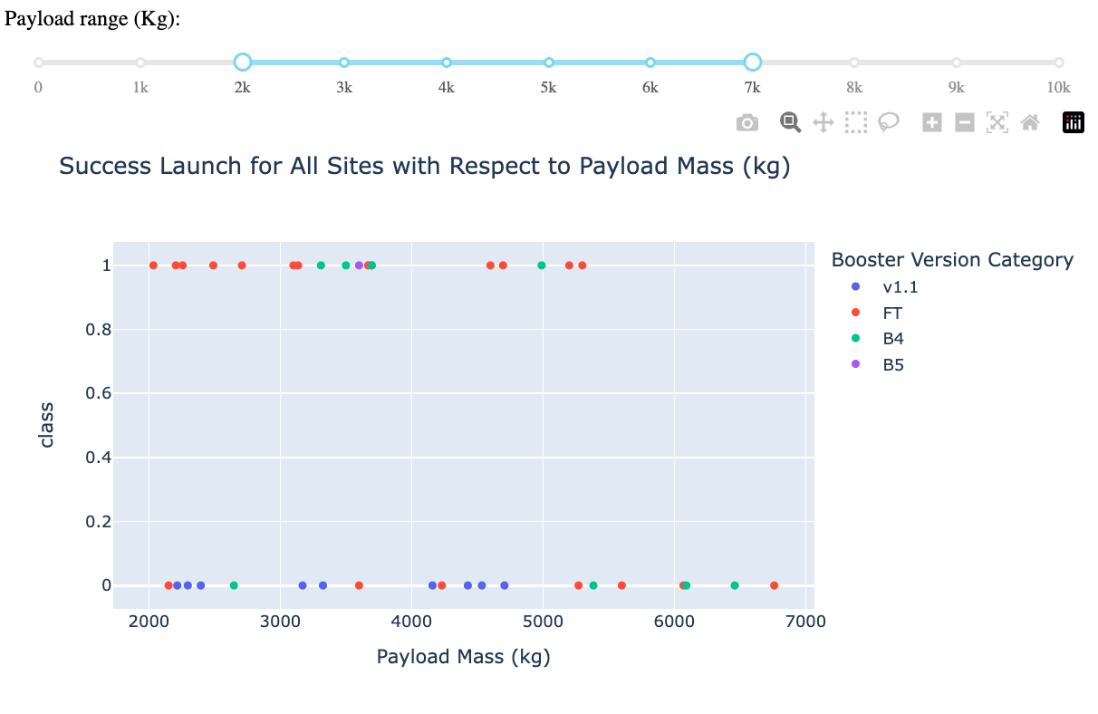
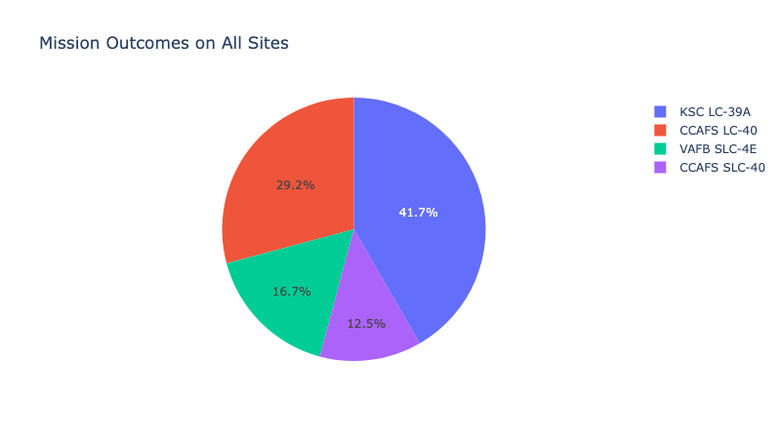
Results
Data Exploration show a correlation between date and success rate, which is also related to the mass of the payload

Slide 18

Section 2

Slide 19
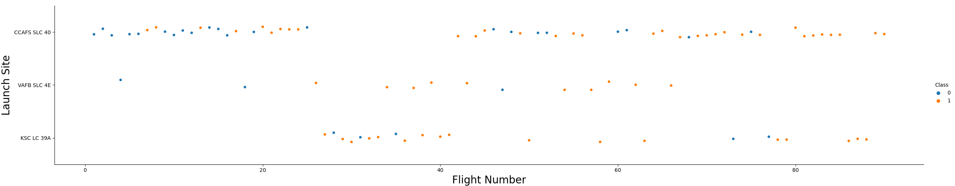
Flight Number vs. Launch Site
Scatter plot of Flight Number vs. Launch Site

Slide 20
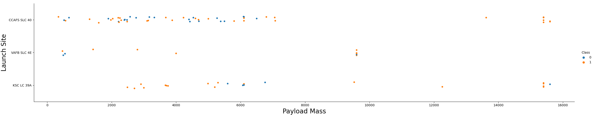
Payload vs. Launch Site
Scatter plot of Payload vs. Launch Site

Slide 21
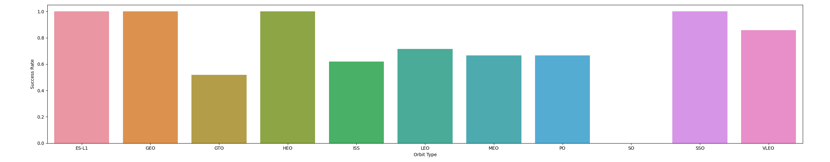
Success Rate vs. Orbit Type
Bar chart for the success rate of each orbit type

Slide 22
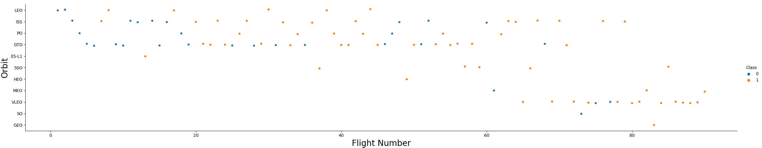
Flight Number vs. Orbit Type
Scatter point of Flight number vs. Orbit type

Slide 23
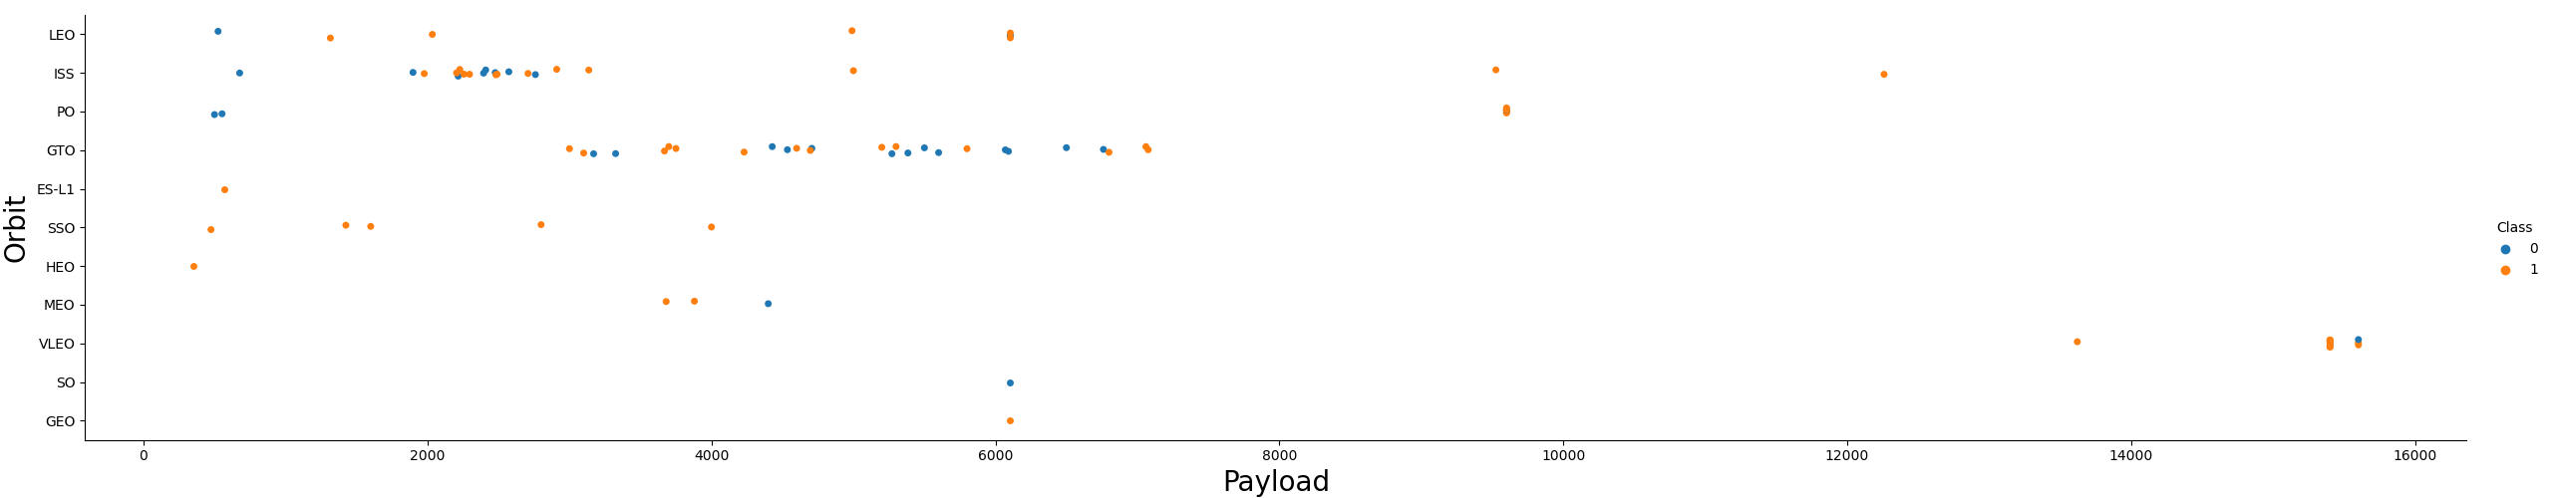
Payload vs. Orbit Type
Scatter point of payload vs. orbit type

Slide 24
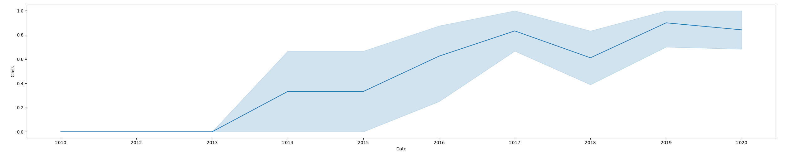
Launch Success Yearly Trend
Line chart of yearly average success rate

Slide 25
All Launch Site Names
Unique of Launch_Site
CCAFS LC-40
VAFB SLC-4E
KSC LC-39A
CCAFS SLC-40
Unique launch sites

Slide 26
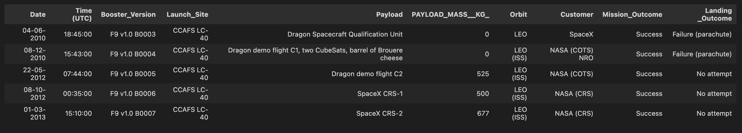
Launch Site Names Begin with 'CCA'
5 records where launch sites begin with `CCA`

Slide 27
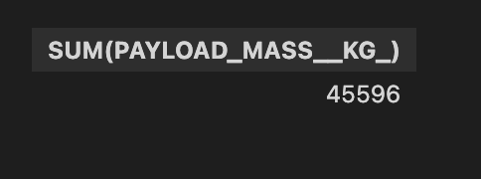
Total Payload Mass
Total payload carried by boosters from NASA

Slide 28
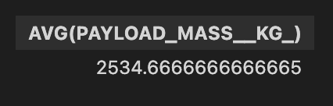
Average Payload Mass by F9 v1.1
Average payload mass carried by booster version F9 v1.1

Slide 29

First Successful Ground Landing Date
Date of the first successful landing outcome on ground pad

Slide 30
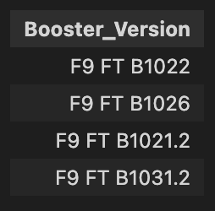
Successful Drone Ship Landing with Payload between 4000 and 6000
Names of boosters which have successfully landed on drone ship and had payload mass greater than 4000 but less than 6000

Slide 31
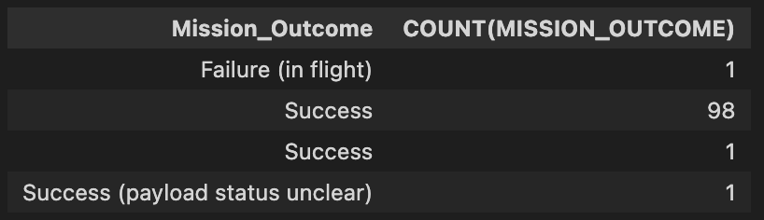
Total Number of Successful and Failure Mission Outcomes
Total number of successful and failure mission outcomes

Slide 32
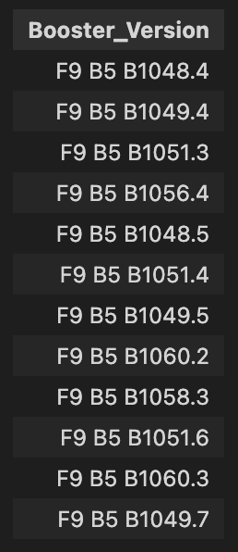
Boosters Carried Maximum Payload
Names of the boosters which have carried the maximum payload mass

Slide 33
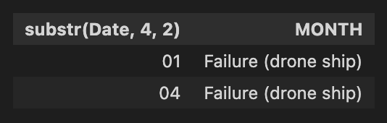
2015 Launch Records
January
April
Failed landing_outcomes in drone ship, their booster versions, and launch site names for in year 2015

Slide 34
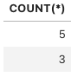
Rank Landing Outcomes Between 2010-06-04 and 2017-03-20
Count of landing outcomes (such as Failure (drone ship) or Success (ground pad) between the date 2010-06-04 and 2017-03-20, in descending order

Slide 35

Section 3

Slide 36
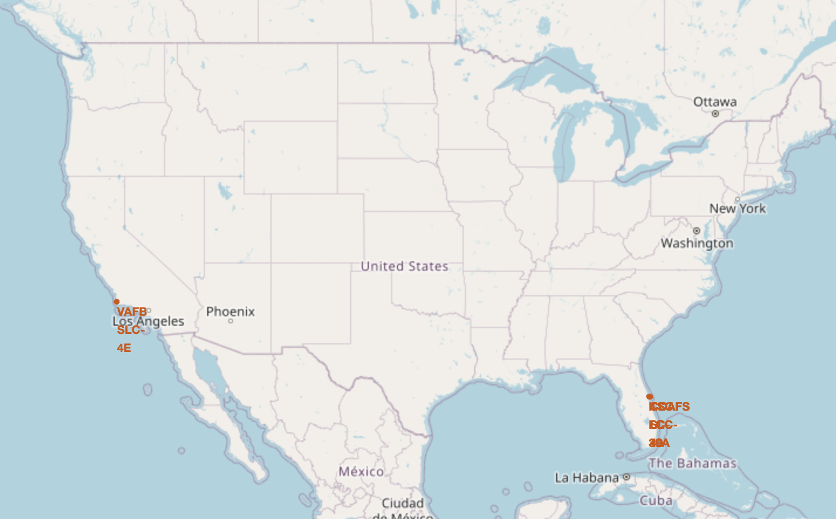
Launch Site Locations
All launch sites are in US soil
They are along coastlines and desserted regions probably to avoid collateral damage in case of failure

Slide 37
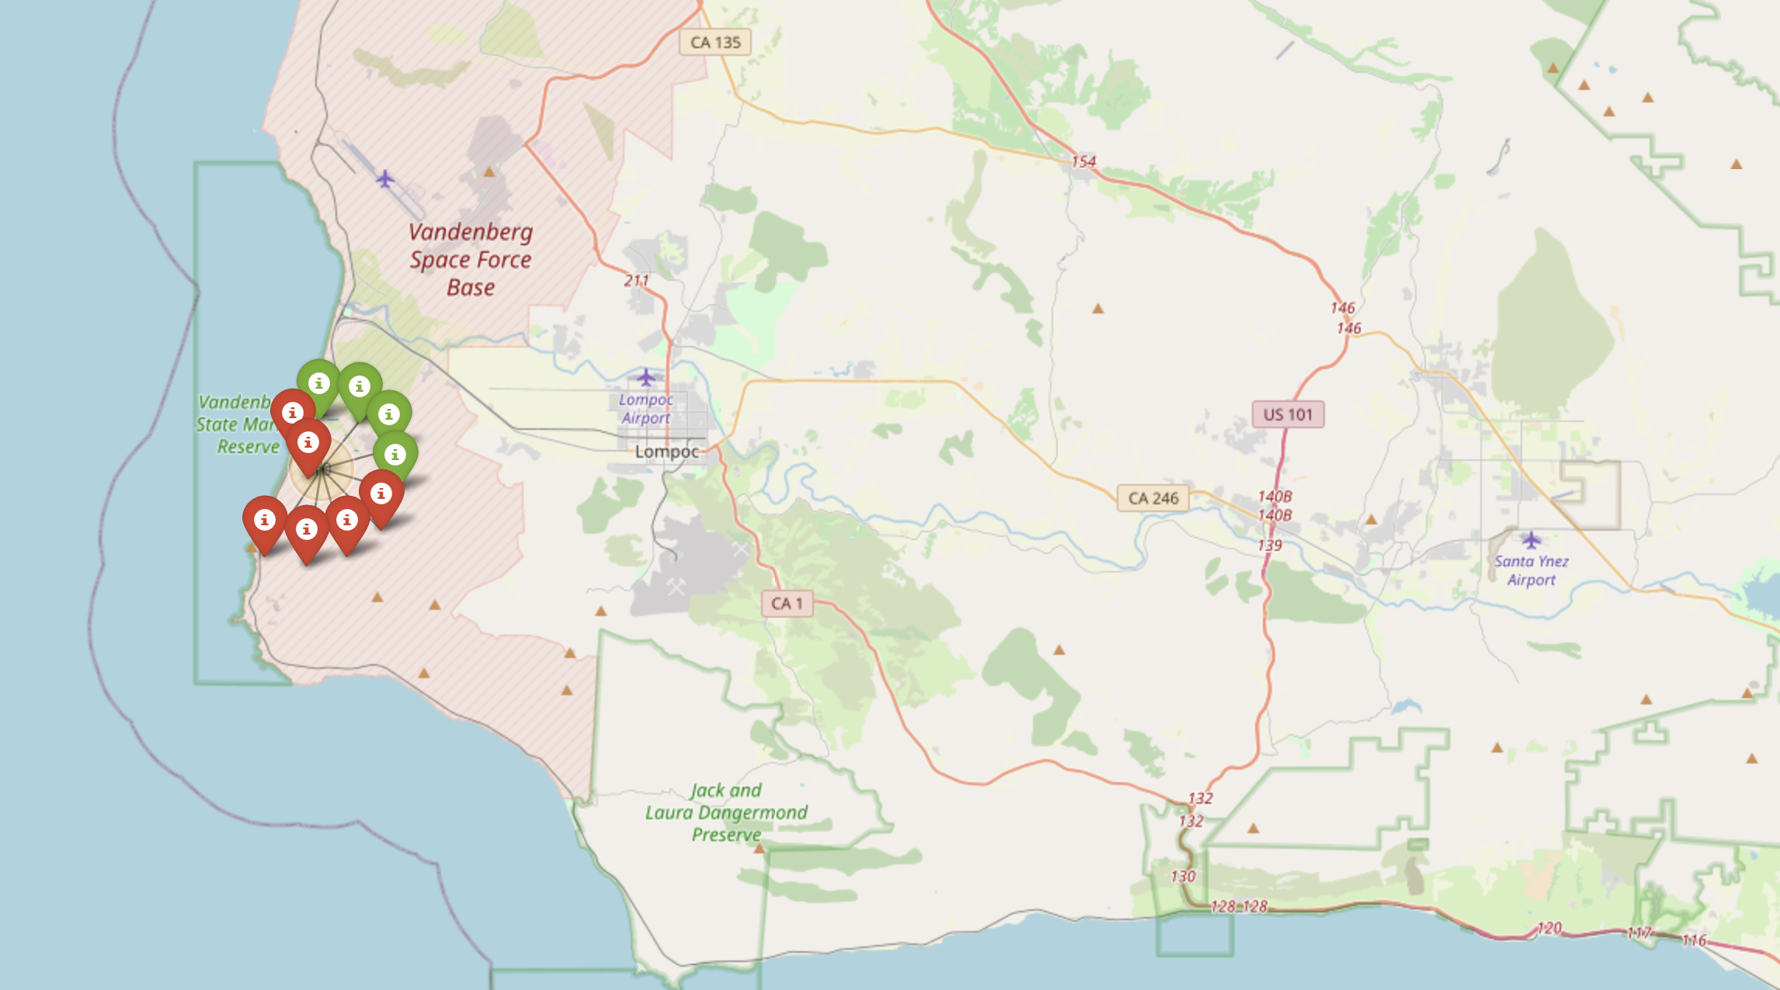
Color labeled Outcomes
When looking at an older launch site, we see the proportion of failed launches is greater, due to the early stages of the project

Slide 38
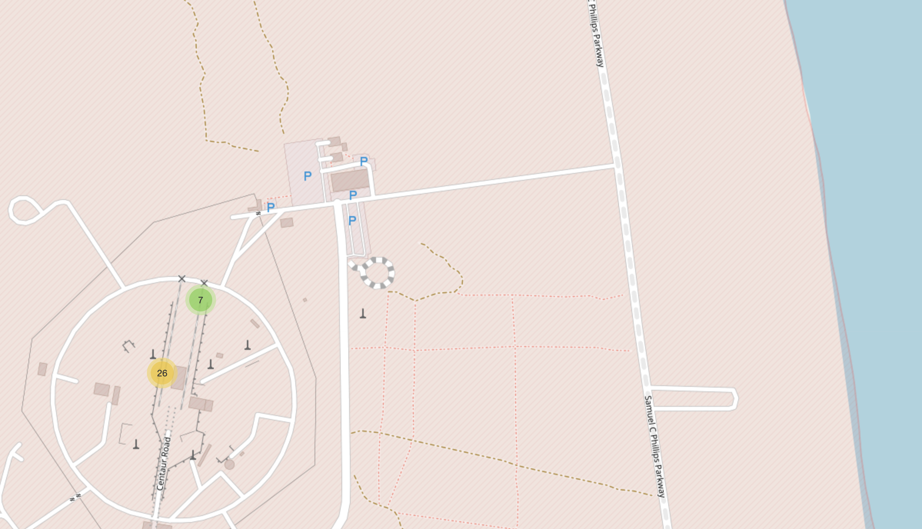
Distance to landmarks
Distance to ocean is as small as possible to allow the rocket to hit the ocean and avoid a catastrophe
0.86
KM

Slide 39

Section 4

Slide 40
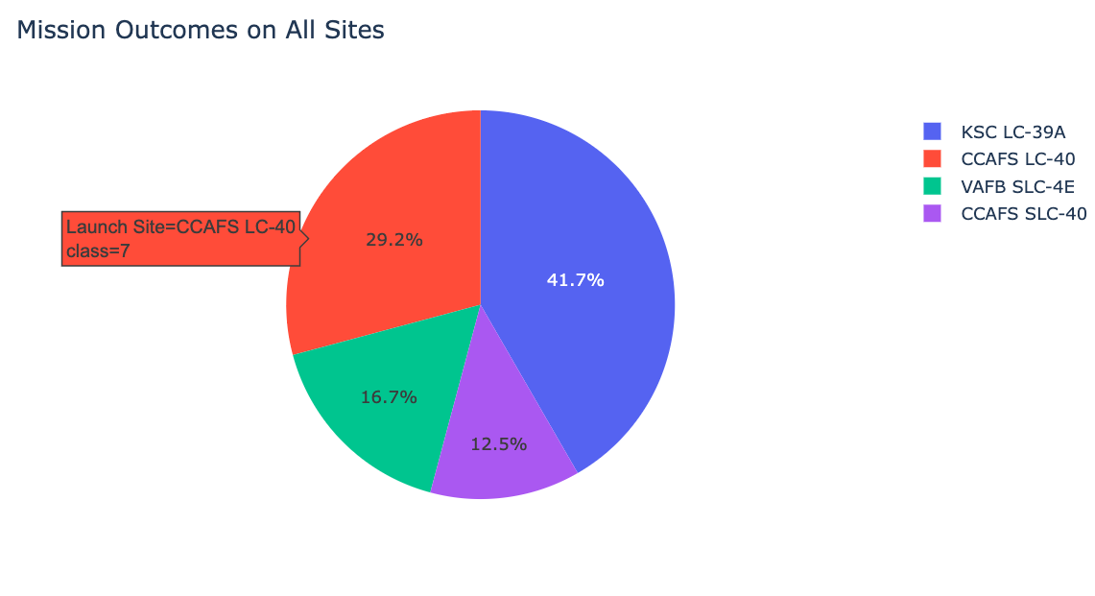
Interactive Dashboard
As we can see, the most recently used launch site is the one with the highest success rate. This means the engineers have learned from previous mistakes

Slide 41
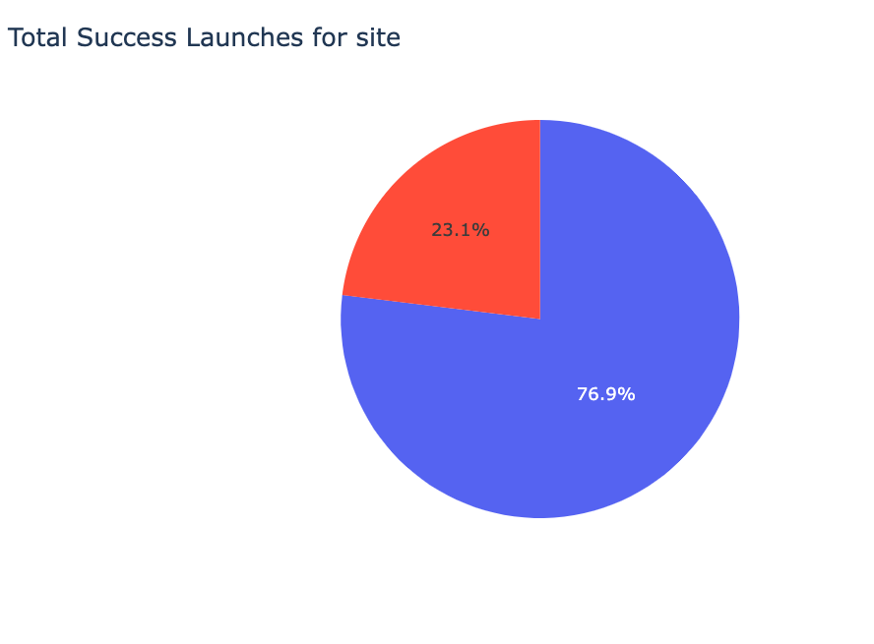
Most Successful launch site
The highest success rate for a launch site is 76.9%
It’s equivalent to a C+ in the American education system.
It’s not bad, but it’s also not good.

Slide 42
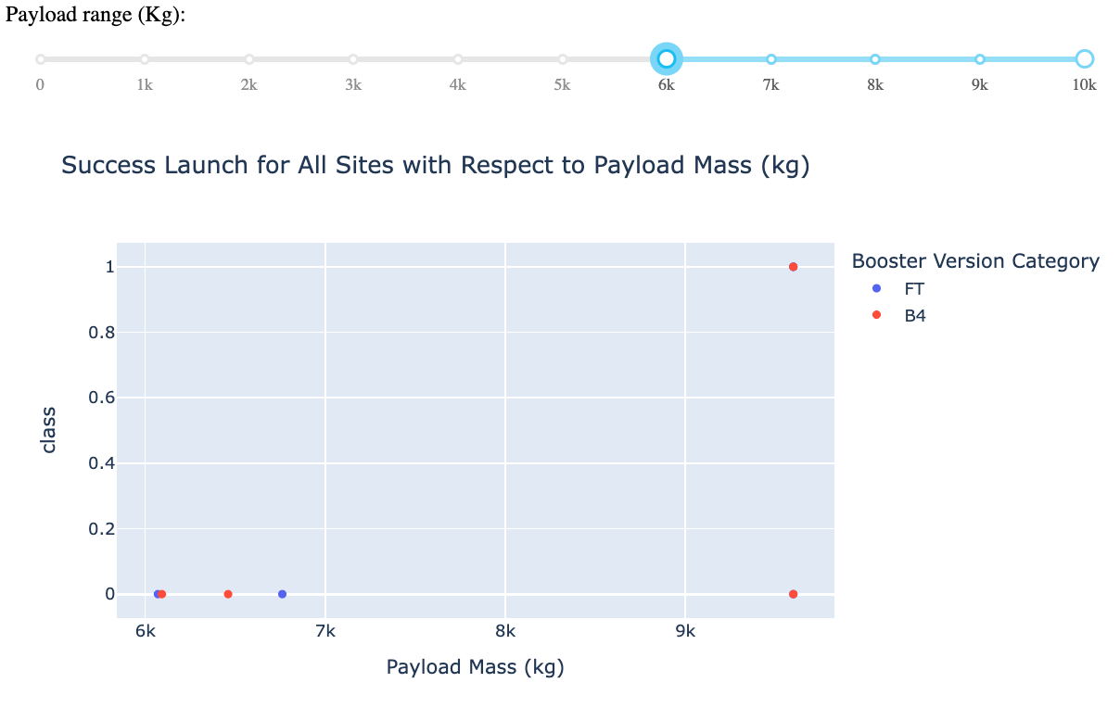
Payload vs launch outcome
From this chart you can see that launches with payloads over 6,000 are very unlikely to be recoverable.
This is not true.
By filtering the data in this way, I am making it seem like payloads over 6000 are not rentable. The truth is there is not enough data.
It would be easy to manipulate people into thinking this is true, which is why this visual representation is a very poor choice

Slide 43

Section 5

Slide 44
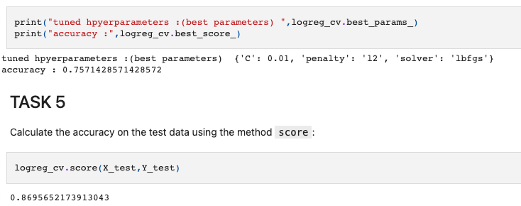
Classification Accuracy
As we can see from this code snippet, the best model was ‘lbfgs’
We cannot infer from the best model which features of the rockets are most likely to be successful.
The whole point of this project is to understand what makes SpaceX successful so we can replicate it.
The next step would be to make 10,000 predictions (or more) with this model by using random values and combinations for the features of the rocket. We can use this data as a guide on making rockets based on which end up being more successful.
Essentially, we’re throwing spaghetti at a wall and seeing what sticks

Slide 45
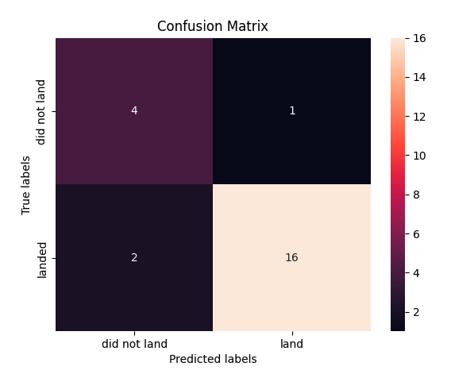
Confusion Matrix
As we can see, our model is inaccurately predicting 3 out of 23 outcomes.
This is an overall accuracy of 20/23 (~88%)
This sounds good, nonetheless it does not tell us what makes a landing successful

Slide 46
Conclusions
The purpose of the project is to use Space X Launch & Landing data to understand what makes them successful so we can create a competitor company called Space Y
The results tell us that SpaceX has improved over the last couple of years in their success rates.
Future Work:
To know what elements are successful, we can use our model with thousands of theoretical predictions to “map out” the features and feature combinations that lead to success, and then answer the project question.

Slide 47
Appendix
Everything is here:
https://github.com/coco-zxc/Capstone

Slide 48


